Slide 2
Introducing Phonics
Phase One
Phase Two
Phase Three
Phase Four
Phase Five
Phase Six

Slide 3

Did You Know…?
The English language has:
over 100 ways to spell those sounds
26 letters
44 sounds
x
u
a
e

Slide 4
Phonics Terminology
systematic synthetic phonics - The teaching of reading and spelling by breaking down words into the smallest unit of sound.
phoneme - Any one of the 44 sounds which make up words in the English language.
grapheme – How a phoneme is written down. There can be more than one way to spell a phoneme. For example, the phoneme ‘ai’ is spelt differently in each of the words ‘way’, ‘make’, ‘fail’, ‘great’, ‘sleigh’ and ‘lady’.
blending – Putting together the sounds in a word in order to read it, e.g. ‘f – r – o – g, frog’.
segmenting – Breaking a word into its constituent sounds in order to spell them, e.g. ‘frog, f – r – o – g’.

Slide 5


What Is Phonics?
reading and spelling
hearing, recognising and using sounds
routine and familiarity
focus on breaking down and building up words (segmenting and blending)
tricky/common exception words

Slide 6
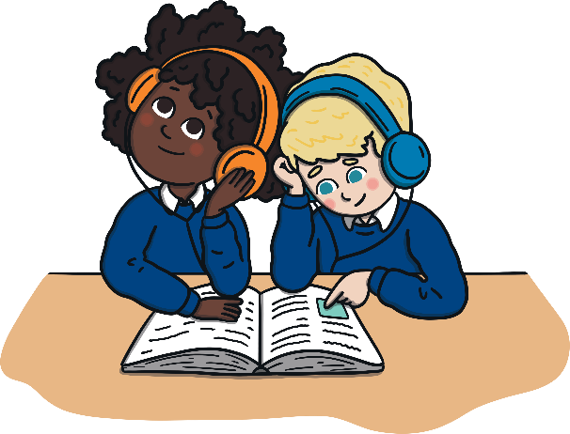
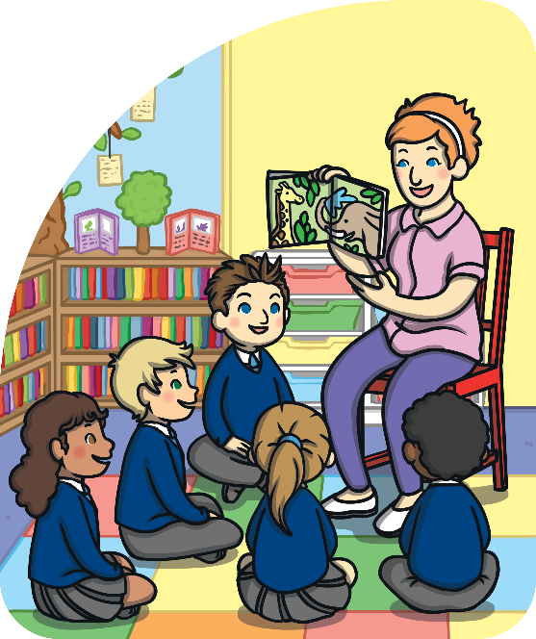
The Progression of Phonics
Phase One - nursery/F1 and/or reception/F2
Phase Two - reception/F2
Phase Three - reception/F2
Phase Four - reception/F2
Phase Five - year 1
Phase Six - year 2

Slide 7
Teaching Phonics
Children are taught reading and spelling daily throughout the week and each session will follow a structured format.
Revisit & Review
The activities used to teach will vary and can be adapted. They are multisensory and appeal to different learning styles. They involve games and individual and group activities as well as teacher-led sessions.
Teach
Practise
Teachers will assess children’s understanding throughout each session and will also assess knowledge of sounds to see whether a child is ready to move on to the next phase.
Apply

Slide 8







Phase One
Phase 1 has seven aspects, with a focus on listening skills.
Environmental sounds
Instrumental sounds
Body percussion
Rhythm and rhyme
Alliteration
Voice sounds
Oral blending and segmenting

Slide 9
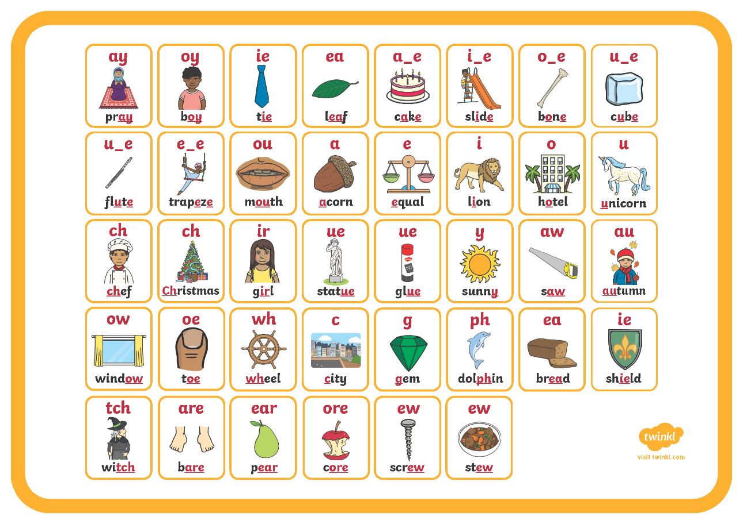
Phase Five

Slide 10
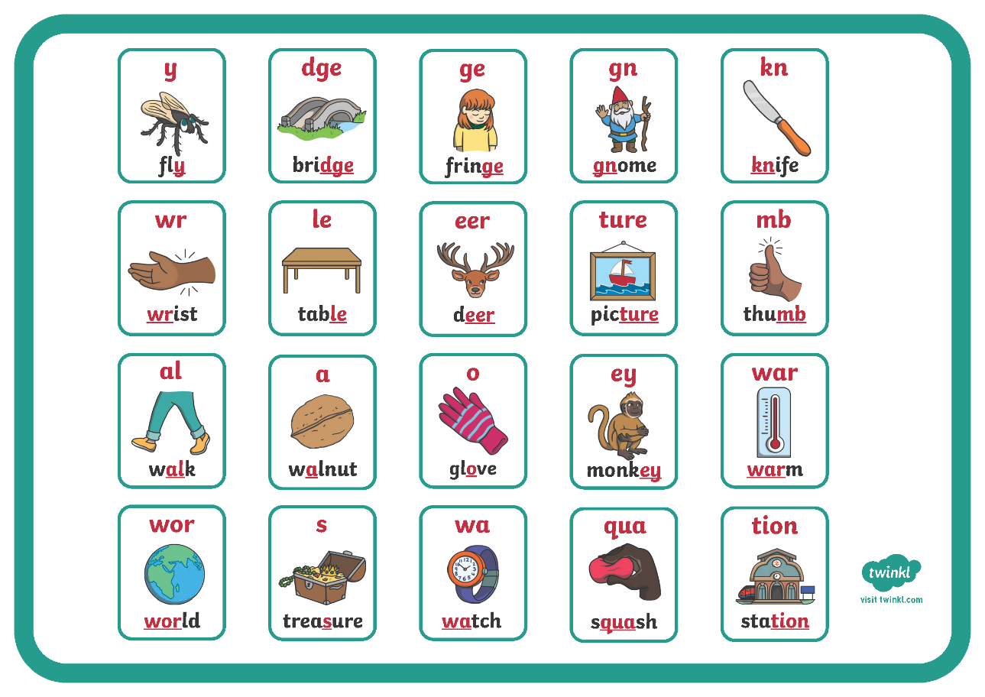
Phase Six

Slide 11
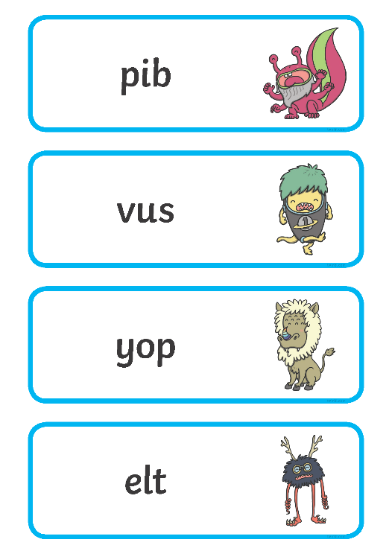
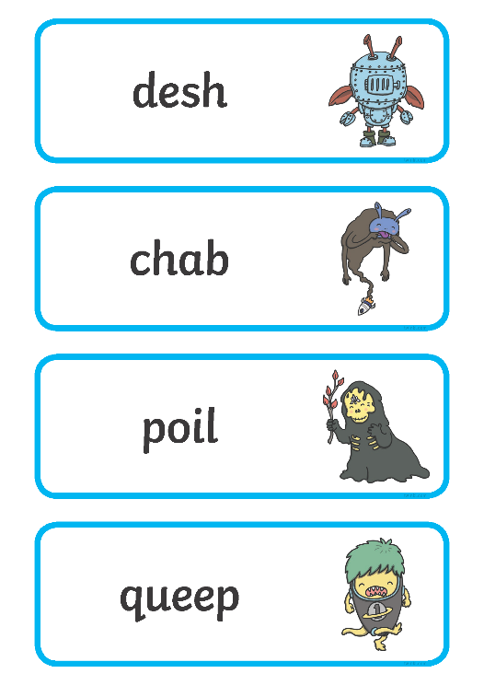
The Year 1 Phonics Screening Check
In June, all year 1 children are expected to complete the year 1 Phonics Screening Check.
The aim is to check that a child is making progress in phonics. They are expected to read a mixture of real words and ‘nonsense’ words.
The outcome of this check enables practitioners to see if any children may need additional support to help them make progress in year 2.

Slide 12

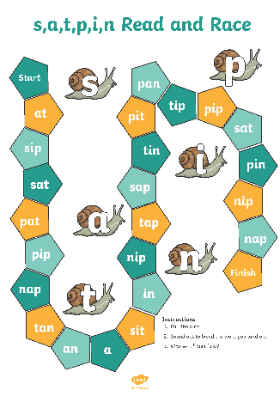
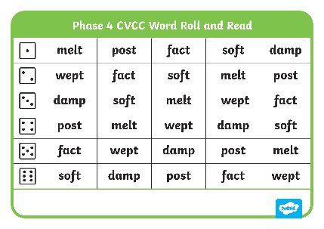


Helping Your Child at Home
play games
provide opportunities for writing
      provide opportunities for reading

