Slide 1















Welcome to hedgehog class
2026

Slide 2






Mrs Wahid
Monday – Wednesday
I moved to Oxfordshire from Yorkshire almost a decade ago and visit the North often.
I have worked at Stadhampton Primary School since 2018. Over the years, I have taught from Year 1 up to Year 6.
I am mama to two boys; Musa and Adam. I’m also cat mum to Luna and Phoenix.
I regularly volunteer to support children in my local community, providing engaging craft activities and experiences that help broaden their understanding of the world.
Some of my hobbies include travelling, spending time in nature and reading.

Slide 3







Miss Morgan
Thursday – Friday
I’m so excited to be teaching Hedgehogs alongside Mrs Wahid this year and getting to know all of the children and families again.
Teaching has always been my dream job, and I absolutely love watching children learn and grow. Outside of school, I enjoy going for runs, spending time with friends and family, and being a mummy to my 15-month-old daughter, Lyla. 💕
A fun fact about me is that when I was younger, I loved drama and was lucky enough to perform in ‘Oliver!’ at the Drury Lane Theatre — an amazing experience I’ll never forget! 🎭
I also used to row for Great Britain and was incredibly proud to win 2 golds and one silver at Europeans in 2017🥇🚣‍♀️
I’m really looking forward to a fantastic year with Hedgehogs and working closely with you all! 🦔

Slide 4
Support staff
Mrs Shortman
Ms Moloney
Millie
Mrs Scragg
Spanish
Mrs Godall

Slide 5


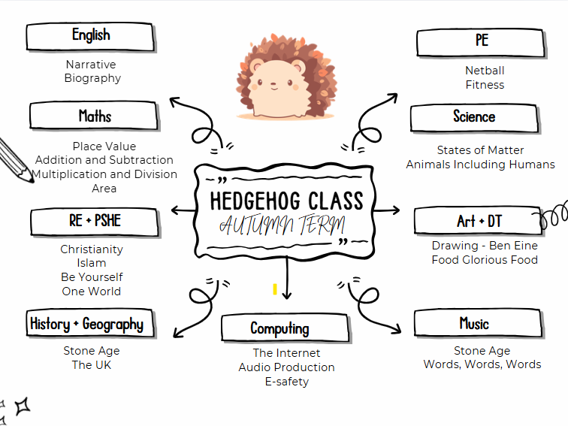


Learning

Slide 6

Things to note
Swimming - Half term 2
Forest school - Half term 3
PE - thursday + Friday

Slide 7

Learning at home
Reading at least four times a week
Times table rockstars (MTC)
Weekly timestable test on a Tuesday

Slide 8
Communication
We are deeply passionate about doing the very best for all of our children. We value strong, positive relationships with families, as we know this partnership is key to supporting every child effectively.
We are always happy to talk and welcome a quick chat at the gate where possible. You can also contact us via the school office by email, however please be aware that responses may not always be immediate during the school day. If you would like to discuss something in more detail, please do ask to arrange a meeting or phone call at a convenient time.

Slide 9






The Weekly bulletin
The weekly bulletin will be sent to you at the beginning of each week. It will include information about some of the learning taking place, as well as important reminders. This is a really useful source of key information to help you support your child effectively.
The School Website
There is a wealth of information available on the school website. Many questions you may have can often be answered by visiting there. Please also keep an eye on the page for our gallery, where we share photos and updates.

